Slide 1

From Data to Decisions: Business Analysis for ASUS
A Study
June ,16, 2025
Rama Al-Majali | 22110119| HTU | Data Science & AI

Slide 2
Introduction
This study covers sales forecasting for ASUS ROG, TUF, and Zephyrus laptops using Power BI and Orange. We'll discuss the data, analysis tools, insights, and their impact on marketing and sales decisions.
Notes:
To answer this, we explored the question:
...
"Our goal is to develop a solution that uses machine learning to predict student performance, allowing schools to provide support before students like Ahmad fall behind."

Slide 3

Data Overview
Notes:
To answer this, we explored the question:
...
"Our goal is to develop a solution that uses machine learning to predict student performance, allowing schools to provide support before students like Ahmad fall behind."

Slide 4


Data Collection
Data Description
The sales data used in this study was collected using the Helium Amazon Extension, a tool that extracts product data from Amazon.
The dataset includes list prices, new prices, and sales ranks for three ASUS laptop models: ROG, TUF, and Zephyrus.
It covers historical sales data for the past year, which allows us to identify trends and forecast future performance for each product.
This data is relevant because it gives us insights into market demand, product performance, and consumer preferences. When we understand how different laptop models perform over time, we can optimise marketing campaigns, manage inventory levels, and refine pricing strategies to increase sales and customer engagement.
Notes:
Ahmad is just one example of a student who could benefit from early intervention, but how can we detect academic risk before it’s too late?

Slide 5

Data Science Tools & Technologies
Notes:
To answer this, we explored the question:
...
"Our goal is to develop a solution that uses machine learning to predict student performance, allowing schools to provide support before students like Ahmad fall behind."

Slide 6


In this study I used two powerful tools for data collection, manipulation, and analysis: Power BI and Orange
Power BI
Orange
1
A business analytics tool used for data visualisation, analysis, and reporting. It allows users to import, clean, and manipulate data, and then create interactive dashboards and reports to uncover insights.
An open-source data visualisation and analysis tool for both novice and expert users. It provides a wide range of machine learning algorithms, including time-series forecasting tools like ARIMA, and enables users to perform predictive analytics and visual exploration of data.
Notes:
Ahmad is just one example of a student who could benefit from early intervention, but how can we detect academic risk before it’s too late?

Slide 7
How These Tools Convert Data into Actionable Insights for Decision Making
Power BI
Orange
1
Power BI enables comprehensive data visualization and interactive reporting, which helps identify key trends, patterns, and anomalies in the sales data. For example, by creating line charts and bar charts, I was able to identify best-selling products, seasonal fluctuations, and sales growth trends over time. These insights are useful in the decision making process because they, for example, help the marketing team adjust campaigns based on performance and enable inventory management to align stock with demand.
Orange enables forecasting algorithms such as ARIMA to make predictions about sales in the future by analysing historical data. When sales are forecasted for each laptop model, the business can make solid based decisions to arrange for the right inventory in advance and avoid both overstocking and running out of stock. It allows sales staff to choose the right ways to advertise and market products moving forward.
Notes:
Ahmad is just one example of a student who could benefit from early intervention, but how can we detect academic risk before it’s too late?

Slide 8

The Business Process
Notes:
To answer this, we explored the question:
...
"Our goal is to develop a solution that uses machine learning to predict student performance, allowing schools to provide support before students like Ahmad fall behind."

Slide 9
The Business Process Supported by Data Science
My data science solution supports two critical business processes; data analysis using Power BI and forecasting using Orange (ARIMA).
These processes help drive data-driven decisions in marketing, sales, and more, ensuring that resources are allocated effectively and strategies are optimised.
Notes:
To answer this, we explored the question:
...
"Our goal is to develop a solution that uses machine learning to predict student performance, allowing schools to provide support before students like Ahmad fall behind."

Slide 10
Data Analysis in Power BI
Data Import and Cleaning
Exploratory Data Analysis
Columns Created for Insights
I Imported data from the CSV files that were created by separating the three laptop models: ROG, TUF, and Zephyrus.
I then used Power Query to clean the data by removing missing values in the sales data and I made sure the data was consistent across all columns.
I created interactive visualisations to analyse the sales trends for each product.
I used line charts to visualise sales over time and compare products.
I created bar charts to compare the total sales of each product and identify the best-selling products.
I used pie charts to show the percentage of total sales contributed by each product.
  Total Sales: I created a calculated measure to capture the accumulative sales value for each product. This was done by summing up the new price over the year.
  Rank vs Price: Added a column to compare each product's sales rank against its price.
  Price Difference: Added a column to show the price gap between the list price and new price for every product.
  Average Price: I created a measure for each product, giving insights into the average price of products sold over time.
Data Dashboards
I created an interactive dashboard combining multiple visuals in a single page for all three products to visualise their sales performance over time and do a comparative analysis for their sales rank by combining the data of all the three products in one table of a unified period of time.
Notes:
Ahmad is just one example of a student who could benefit from early intervention, but how can we detect academic risk before it’s too late?

Slide 11
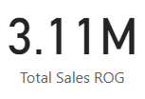


Visualisations and Insights from Power BI
Asus ROG Strix Laptop
This value reflects the cumulative total of all recorded ROG Strix laptop prices over the analysis period. Assuming each price point is equal to ASUS selling a minimum of one laptop per day, this value can be interpreted as the estimated minimum total sales revenue for the product across the year.
Data Card for ‘Total Sales’ Measure
The value indicates that the average new price of the ROG model across all recorded entries is approximately $1,280.
Data Card for ‘Average Price’ Measure
Notes:
Ahmad is just one example of a student who could benefit from early intervention, but how can we detect academic risk before it’s too late?

Slide 12
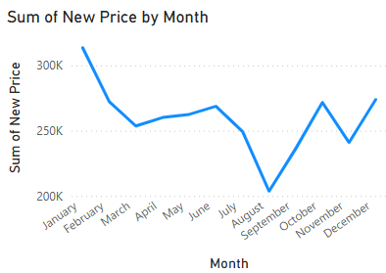
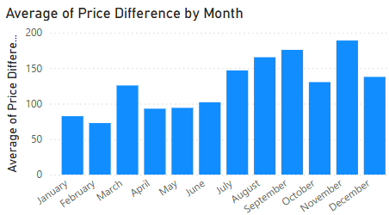
Visualisations and Insights from Power BI
Asus ROG Strix Laptop
This visualises the average price difference for the ROG laptop across each month.
This visualises the total new price value of the ROG laptop sales aggregated per month over the course of a year.
Notes:
Ahmad is just one example of a student who could benefit from early intervention, but how can we detect academic risk before it’s too late?

Slide 13
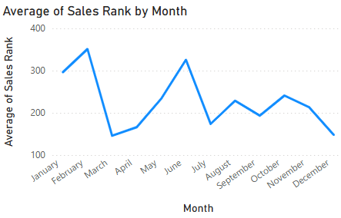
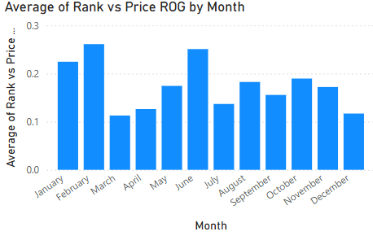
Visualisations and Insights from Power BI
Asus ROG Strix Laptop
This bar chart shows the average Rank vs Price ratio for ROG laptops by month. A higher value suggests that the product had a worse sales rank relative to its price.
This line chart shows the average sales rank of ROG laptops by month, where a higher rank indicates worse performance.
Notes:
Ahmad is just one example of a student who could benefit from early intervention, but how can we detect academic risk before it’s too late?

Slide 14
Insights
Asus ROG Strix Laptop
The drop of sum of new price in August–September could indicate lower sales volume, discounting, or a temporary dip in demand. The increase toward the end of the year could be linked to holiday shopping seasons, suggesting seasonal demand patterns.
1
The average price difference for ROG laptops was lowest in February and March, indicating minimal discounting during those months. The highest differences appeared in October and December, likely due to seasonal promotions or holiday discounts. From June to September, there was a steady increase in price differences, suggesting a period of adjusted pricing, possibly in response to market trends or competitive pressure.
2
3
The average of sales rank had the worst performance occurred in February and June, with ranks above 300. The best months were April and December likely due to holiday demand, where the rank dropped closer to 150, indicating stronger sales.
The rank vs price ratio peaked in March and June, implying those months had the least favorable balance between price and performance. Conversely, April and December had the lowest ratios, suggesting that ROG laptops were more competitively priced or had stronger performance during those periods like the holidays.
4
Notes:
Ahmad is just one example of a student who could benefit from early intervention, but how can we detect academic risk before it’s too late?

Slide 15
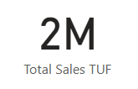
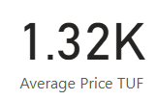
Visualisations and Insights from Power BI
Asus TUF Laptop
This value reflects the cumulative total of all recorded TUF laptop prices over the analysis period. Assuming each price point is equal to ASUS selling a minimum of one laptop per day, this value can be interpreted as the estimated minimum total sales revenue for the product across the year.
Data Card for ‘Total Sales’ Measure
The value indicates that the average new price of the TUF model across all recorded entries is approximately $1,280.
Data Card for ‘Average Price’ Measure
Notes:
Ahmad is just one example of a student who could benefit from early intervention, but how can we detect academic risk before it’s too late?

Slide 16
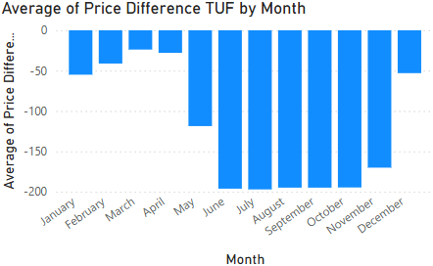
Visualisations and Insights from Power BI
Asus TUF Laptop
This chart shows the average price difference for the TUF laptop by month. The values are mostly negative, meaning the new price was consistently lower than the list price.
This line chart displays the average new price of the TUF laptop by month.
Notes:
Ahmad is just one example of a student who could benefit from early intervention, but how can we detect academic risk before it’s too late?

Slide 17
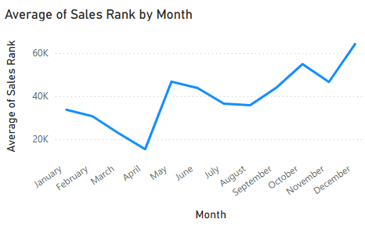
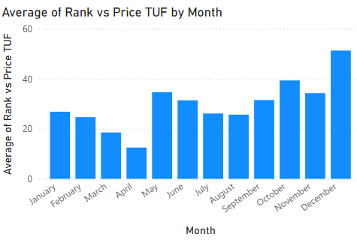
Visualisations and Insights from Power BI
Asus TUF Laptop
This bar chart shows the average Rank vs Price ratio for the TUF laptop by month. A higher value means the product had a worse sales rank relative to its price.
This line chart shows the average sales rank of the TUF laptop by month, where a higher rank indicates lower sales performance.
Notes:
Ahmad is just one example of a student who could benefit from early intervention, but how can we detect academic risk before it’s too late?

Slide 18
Insights
Asus TUFLaptop
Prices were lower from January to April, then rose sharply in May and June, peaking around $1,400. They stayed stable through October, before dropping in November and December, likely due to holiday discounts.
1
For the difference between the list and new price, the largest discounts occurred from June to November, with August and October hitting around –200, indicating aggressive markdowns. This suggests extended promotional pricing during the second half of the year.
2
TUF’s sales rank performed best in April, with the lowest average rank, and worst in December, where the rank peaked above 60,000. After a mid-year dip in rank, the trend gradually worsened toward the end of the year indicating that there were better promotions for other products that sold more in the holiday season
3
The ratio of rank vs. price was lowest in April, indicating strong performance for its price, and highest in December, suggesting poor performance despite a relatively higher price.
4
Notes:
Ahmad is just one example of a student who could benefit from early intervention, but how can we detect academic risk before it’s too late?

Slide 19
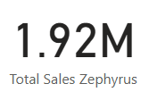
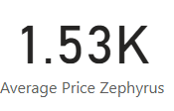
Visualisations and Insights from Power BI
Asus Zephyrus Laptop
This value reflects the cumulative total of all recorded Zephyrus laptop prices over the analysis period. Assuming each price point is equal to ASUS selling a minimum of one laptop per day, this value can be interpreted as the estimated minimum total sales revenue for the product across the year.
Data Card for ‘Total Sales’ Measure
The value indicates that the average new price of the Zephyrus model across all recorded entries is approximately $1,280.
Data Card for ‘Average Price’ Measure
Notes:
Ahmad is just one example of a student who could benefit from early intervention, but how can we detect academic risk before it’s too late?

Slide 20
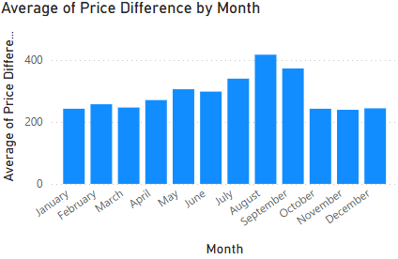
Visualisations and Insights from Power BI
Asus Zephyrus Laptop
This bar chart shows the average price difference for the Zephyrus laptop by month.
This line chart shows the sum of new price for the Zephyrus laptop by month.
Notes:
Ahmad is just one example of a student who could benefit from early intervention, but how can we detect academic risk before it’s too late?

Slide 21
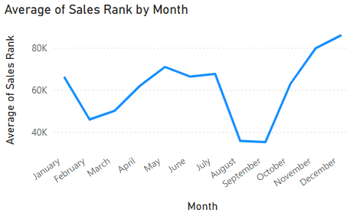
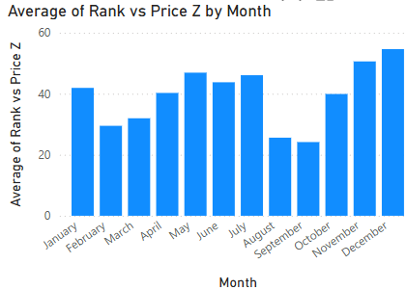
Visualisations and Insights from Power BI
Asus ZephyrusLaptop
This bar chart shows the average Rank vs Price ratio for the Zephyrus laptop by month.
This line chart displays the average sales rank of the Zephyrus laptop by month.
Notes:
Ahmad is just one example of a student who could benefit from early intervention, but how can we detect academic risk before it’s too late?

Slide 22
Insights
Asus ZephyrusLaptop
Sales were strong from January to May, then dropped sharply in June, hitting the lowest point of the year. The total rebounded in July and August, and remained relatively stable from September to December. This indicates a mid-year sales dip, followed by steady recovery, possibly due to restocking or renewed demand.
1
The average price difference was fairly consistent from January to June, then peaked in August and September, with values above 400, indicating larger discounts or markups. After October, the difference dropped back to earlier levels. This suggests a period of aggressive pricing or promotional activity in late summer.
2
The lowest, best, performance occurred in August and September, with ranks around 35K, while the worst performance was in December, where rank peaked above 85K. The sharp improvement in late summer followed by a steep decline toward year-end suggests a temporary boost in demand, possibly due to promotions, followed by reduced competitiveness in the holiday season.
3
The lowest rank vs. price ratios occurred in August and September, indicating the product performed well relative to its price. The highest ratios appeared in November and December, suggesting poorer sales performance with higher prices. This trend reflects a strong mid-year performance followed by a weaker price-to-performance balance at year-end.
4
Notes:
Ahmad is just one example of a student who could benefit from early intervention, but how can we detect academic risk before it’s too late?

Slide 23
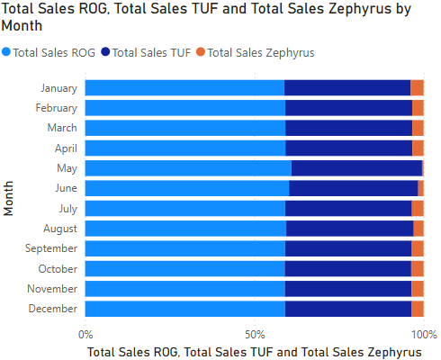
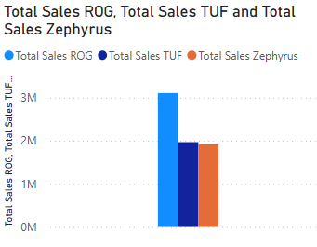
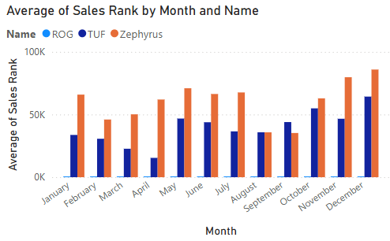
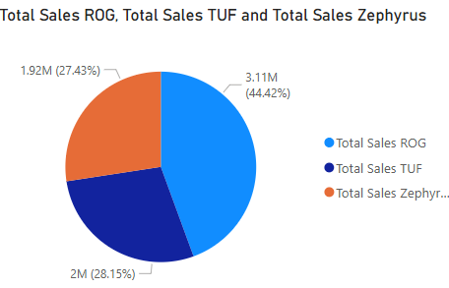
Visualisations and Insights from Power BI
All Products
This grouped bar chart compares the average sales rank of the laptops across each month.
This stacked bar chart shows the monthly proportion of total sales for all the laptops.
These charts compare the total sales of the three ASUS laptops.
Notes:
Ahmad is just one example of a student who could benefit from early intervention, but how can we detect academic risk before it’s too late?

Slide 24
Insights
All Products
ROG leads the sales significantly with over 3 million in sales, while TUF and Zephyrus are close behind with just under 2 million each. This highlights ROG as the best-selling product overall, while TUF and Zephyrus performed similarly in terms of total revenue.
1
ROG dominates with 44.42% of total sales (3.11M), followed by TUF at 28.15% (2M) and Zephyrus at 27.43% (1.92M). This highlights ROG as the most profitable model, while TUF and Zephyrus contributed nearly equal shares to overall sales.
2
ROG consistently outperformed the other two, maintaining lower average ranks. Zephyrus had the highest average ranks most months, indicating weaker performance, especially in December, where its rank approached 90K. TUF remained in the middle, showing steady performance but trailing behind ROG. This visualisation clearly shows that ROG led in sales performance throughout the year.
3
Across all months, ROG consistently contributed the largest share, making up over half of total sales in most months. TUF held the second-largest portion, while Zephyrus made up the smallest share throughout the year. This chart emphasises ROG's dominance in sales performance.
4
Notes:
Ahmad is just one example of a student who could benefit from early intervention, but how can we detect academic risk before it’s too late?

Slide 25
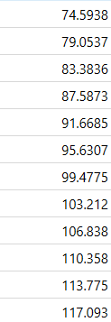
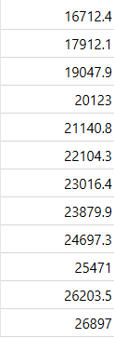
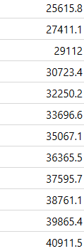

Forecasting in Orange
In Orange, I performed forecasting using the ARIMA model. I first imported the sales data and converted it into a time series using the “From Time Series” widget. I then applied the ARIMA Model to forecast future values, specifically the sales rank for the next 12 months. I then evaluated the model using the model evaluation widget The forecasted values are shown in the data tables.
ROG: The forecasted values are shown in the data table, gradually increasing over time, indicating a potential decline in performance.
TUF: The values increase steadily from around 16,700 to over 26,800, indicating a projected decline in performance over the next 12 months.
Zephyrus: The values increase steadily from around 25,600 to over 40,900, indicating a projected decline in performance over the next 12 months.
Notes:
Ahmad is just one example of a student who could benefit from early intervention, but how can we detect academic risk before it’s too late?

Slide 26

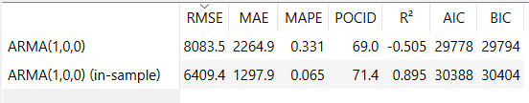
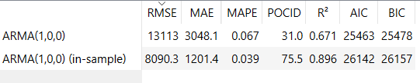
Forecasting in Orange
For ROG, the error was low, but the R² score was negative, which means the forecast didn’t fit the real data very well. For TUF, the errors were higher, but the model was more reliable, with a better R² and a POCID score showing decent prediction accuracy. For Zephyrus, the forecast had the highest error, but when tested within the known data (in-sample), it performed much better with an R² of 0.896—meaning it followed the actual trend very closely. This means that while some forecasts were more accurate than others, they all gave useful insights to help with planning and decision-making.
ROG
TUF
Zephyrus
Notes:
Ahmad is just one example of a student who could benefit from early intervention, but how can we detect academic risk before it’s too late?

Slide 27
Insights
Without strategic marketing or pricing adjustments, ASUS may lose competitiveness in the coming year. These insights help the company plan interventions like promotions, product updates, or pricing changes to maintain sales momentum.
Notes:
To answer this, we explored the question:
...
"Our goal is to develop a solution that uses machine learning to predict student performance, allowing schools to provide support before students like Ahmad fall behind."

Slide 28
Value of the business solution to the marketing department and the company.
Power BI
Orange
1
The data science solutions gives marketing clear information based on data, helping them make better decisions about pricing, promotions and which products to emphasise. Using Power BI dashboards, we found what influenced seasonal sales, the most sold products, and how prices affected their sales rank. Consequently, marketers can organise specific campaigns when new models sell well and think about changing prices for those that do not.
The models offer a way to forecast sales in advance, spot when sales might fall and take early action to steer the company in the right direction. In the company’s case, it means better inventory levels, proper budgeting and smarter growth by ensuring resources go where they are most effective.
Notes:
To answer this, we explored the question:
...
"Our goal is to develop a solution that uses machine learning to predict student performance, allowing schools to provide support before students like Ahmad fall behind."

Slide 29

The Value of The Collected Data & Insights
Notes:
To answer this, we explored the question:
...
"Our goal is to develop a solution that uses machine learning to predict student performance, allowing schools to provide support before students like Ahmad fall behind."

Slide 30
The value of the collected data and extracted insights for Brand Managers, Sales Managers, and Company Executives
Brand Managers
Value:
Brand managers are responsible for positioning and maintaining the image of each product line. The Power BI analysis revealed that ROG had the highest total sales (3.11M) and strong average performance, especially in April and December. TUF and Zephyrus, while still competitive, showed rising price-to-rank ratios, signaling weaker sales relative to price in the second half of the year.
Impact of value:
Brand managers can use this to justify more marketing support for ROG during high-performing periods and reassess how TUF and Zephyrus are positioned or promoted, especially as their sales rank worsens despite price drops.
Why it’s valuable:
It shows whether a brand’s pricing aligns with customer response. When Zephyrus showed increased price differences but worsened rank, brand managers can infer that price cuts didn’t boost performance and might signal a perception issue rather than pricing.
Notes:
To answer this, we explored the question:
...
"Our goal is to develop a solution that uses machine learning to predict student performance, allowing schools to provide support before students like Ahmad fall behind."

Slide 31
The value of the collected data and extracted insights for Brand Managers, Sales Managers, and Company Executives
Sales Managers
Value:
Sales managers need to understand what drives revenue, when to push products, and how to respond to market shifts. The insights were seasonal trends showed peaks in ROG sales during January and May, and dips in August and September and the ARIMA forecasts for TUF and Zephyrus showed a steady rise in sales rank, implying declining performance over the next 12 months.
Impact of value:
Sales managers can plan promotional pushes during low-performing months, use forecasted rank declines to implement sales incentives or bundling before the drop worsens, and identify when discounts fail to boost rank.
Why it’s valuable:
It enables data-backed sales strategy adjustments—rather than guessing, they can respond directly to what the data shows customers are reacting to.
Notes:
To answer this, we explored the question:
...
"Our goal is to develop a solution that uses machine learning to predict student performance, allowing schools to provide support before students like Ahmad fall behind."

Slide 32
The value of the collected data and extracted insights for Brand Managers, Sales Managers, and Company Executives
Company Executives
Value:
The data and inisghts give a strategic value to executives. They are focused on profitability, growth, and long-term investment decisions. They need a holistic view supported by quantifiable insights. The 44.42% sales share of ROG shows it is the core revenue driver, justifying investment in innovation or marketing expansion. Orange forecasts reveal declining rank trends across all three products, prompting a need for product lifecycle management or new product development discussions. Performance metrics from Orange (e.g., Zephyrus forecast R² of 0.896) provide reliable projections, useful for budgeting and strategic planning.
Impact of value:
Executives can decide where to allocate budget based on product health. They can also use forecasts to guide inventory and supply chain decisions
They can identify risk early and take corrective action proactively—like investing in TUF’s branding or re-engineering Zephyrus.
Why it’s valuable:
The insights support data-driven strategic planning decisions, reduces risk, and enhances confidence in board-level decisions.
Notes:
To answer this, we explored the question:
...
"Our goal is to develop a solution that uses machine learning to predict student performance, allowing schools to provide support before students like Ahmad fall behind."

Slide 33

The Design of The Data Science Solution
Notes:
To answer this, we explored the question:
...
"Our goal is to develop a solution that uses machine learning to predict student performance, allowing schools to provide support before students like Ahmad fall behind."

Slide 34
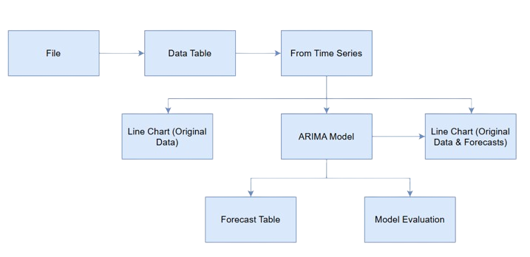
Flowchart
Converts the data into a time series by specifying the Time column and the target variable. Time series models like ARIMA require this structured format to function.
Lets us preview, filter, or edit the dataset before modeling. It helps confirm that the time column is correctly read and that numeric variables like sales rank or price are available.
Applies the ARIMA algorithm to analyse past data and forecast future values. This is the core forecasting tool that lets us predict future sales rank trends.
Loads the dataset. It provides the raw sales data needed for forecasting.
Displays the forecasted values alongside the original time series as a single line chart. It allows to visually compare real vs predicted trends and identify when performance is expected to rise or fall.
Shows the raw forecasted values in a table format for reference or export. Useful for presenting the exact numeric predictions and understanding how performance evolves month by month.
Evaluates how accurate the ARIMA model is using metrics like RMSE, MAPE, R², etc. It validates the forecasts and chooses the best-performing model setup.

Slide 35
How The Solution Solves The Problem
This workflow takes the historical sales rank data and turns it into predictive insights by structuring the data as a time series, forecasting future trends using ARIMA, validating the forecast’s accuracy, and visualizing both real and predicted performance in one view.
This helps the team make data-backed decisions around marketing, budgeting, and product strategy — especially for identifying potential drops in sales and acting before they happen.
Notes:
To answer this, we explored the question:
...
"Our goal is to develop a solution that uses machine learning to predict student performance, allowing schools to provide support before students like Ahmad fall behind."

Slide 36

Recommendations Based on Insights
Notes:
To answer this, we explored the question:
...
"Our goal is to develop a solution that uses machine learning to predict student performance, allowing schools to provide support before students like Ahmad fall behind."

Slide 37
Increase Marketing Support for ROG Laptops
Reassess the Positioning and Price Strategy for Zephyrus
Boost TUF Sales During Q3 (July–September)
ROG accounted for 44.42% of total sales and consistently showed the strongest sales rank performance throughout the year.
Recommendation: Allocate more advertising and promotional budget to ROG during high-performing months (e.g., May, October, December) to maximize ROI.
TUF’s performance dipped in Q3, even with relatively stable pricing.
Recommendation: Launch seasonal bundles or student discounts during this period to stimulate demand and improve sales rank performance.
Despite heavy discounts (seen in high price difference months like August–September), Zephyrus’ sales rank worsened, indicating price cuts alone weren’t effective.
Recommendation: Conduct user feedback surveys and explore whether design, features, or brand perception are limiting sales performance.
Prepare for a Downward Trend in 2025
Use Forecast Data for Inventory and Budget Planning
Focus on Price-to-Performance Optimisation
Orange ARIMA forecasts for TUF and Zephyrus predict rising sales rank values, signaling a decline in future competitiveness.
Recommendation: Begin planning product refreshes or feature upgrades, and align marketing messages with unique value propositions before the forecasted decline materializes.
Rank vs Price” metrics showed that higher prices did not always result in better rank, especially for Zephyrus.
Recommendation: Reevaluate pricing tiers across models to ensure each one aligns with customer expectations and competitive benchmarks.
Forecasted values provide reliable sales expectations for the next 12 months (e.g., TUF forecast rank rising from ~25K to ~40K).
Recommendation: Adjust inventory, staffing, and marketing calendars based on forecast peaks and dips to reduce overspending and stock issues.
Notes:
Ahmad is just one example of a student who could benefit from early intervention, but how can we detect academic risk before it’s too late?

Slide 38

Evalutation of The Data Science Solution

Slide 39
How the Solution Meets User & Business Requirements
1
Supports Strategic Decision-Making
The solution provides clear, visual insights on pricing trends, sales rank, and seasonal performance. This directly supports the needs of marketing and sales managers for data-backed decision-making.
Forecasting Future Performance
The ARIMA forecasting in Orange gives company stakeholders a 12-month outlook on product performance. This helps with resource planning, inventory management, and early interventions if a product is predicted to decline.
Product-Specific Analysis
By analyzing ROG, TUF, and Zephyrus separately, your solution delivers model-specific recommendations, which aligns with how brand and product managers operate.
Accessible Visualisations
The Power BI dashboards turn raw data into interactive visuals, making it easy for non-technical stakeholders to understand patterns and make quick decisions.

Slide 40
Identified Gaps & Potential Improvements
1
Limited Variables in Forecasting
The ARIMA model used only one target variable. Factors like price changes, promotions, or reviews weren’t included.
Improvement: Use multivariate time series models in tools like Python or Orange for richer forecasting.
No Real-Time Updates
The solution uses static datasets extracted manually. This limits real-time responsiveness.
Improvement: Integrate the Power BI dashboards with live data sources via APIs for ongoing, up-to-date tracking.
No User Feedback Loop
The solution is analytical, but doesn't yet include user feedback data like reviews or ratings to explain rank fluctuations.
Improvement: Incorporate qualitative data or sentiment analysis from reviews to provide a deeper understanding of why performance shifts occur.
Scalability
The approach works well for 3 products, but would become manual and repetitive for 20+ products.
Improvement: Create automated pipelines and use scripts or tools like Power Query to scale analysis and forecasting.

Slide 41
Evaluation Summary
The solution meets core requirements user and business requirements like analysis, forecasting, and decision support. It delivers practical, product-level insights for marketing and planning teams, but for it to become a full enterprise-grade solution, it needs to have multivariable forecasting, real-time integration, and scalable automation.
Notes:
To answer this, we explored the question:
...
"Our goal is to develop a solution that uses machine learning to predict student performance, allowing schools to provide support before students like Ahmad fall behind."

Slide 42

Social, Legal, and Ethical Implications of Using Data

Slide 43

Social Implications
Transparency & Trust
Using publicly available data responsibly helps maintain consumer trust. However, drawing conclusions from automated rankings or pricing patterns must be presented clearly and not misused to manipulate perception.
Digital Inequality
Over-reliance on data tools may favor large brands with data access, unintentionally disadvantaging small businesses that can't leverage such analytics.
Employee Implications
Forecasting models can influence sales team strategies, hiring, or inventory decisions—so the data must be accurate and fairly interpreted to avoid decisions that impact staff or customers unfairly.

Slide 44
Legal Implications
Data Source Legality
While Helium and Amazon data are publicly accessible, scraping or collecting it must comply with platform terms of service. If scraped data is reused commercially without permission, it may violate intellectual property rules or data usage policies.
Data Protection & Privacy
Although the data does not contain personal information, it’s still important to ensure that no consumer or seller-identifiable data is collected, stored, or shared.
Licensing & Attribution
Tools like Power BI and Orange are used under specific licenses. Ensuring software is properly licensed and used within scope is part of responsible legal use.

Slide 45

Ethical Implications
Bias & Interpretation
If data is misinterpreted like assuming sales rank = exact sales quantity, it can lead to misleading insights or biased recommendations. Ethical data use requires clarity about what the data can and cannot prove.
Data Manipulation Risks
Ethically, forecasts and visualisations should be used to inform, not manipulate. For example, overstating a declining model’s strength to justify continued investment would be unethical.
Responsible Automation
Forecasting and analytics should support human judgment, not replace it blindly. Decision-makers must still review outputs critically and consider non-data factors.

Slide 46

Potential Data Security Threats & Protection Measures

Slide 47

Potential Data Security Threats
Unauthorized Access to Stored Files
If datasets or Power BI dashboards are stored on unprotected devices or cloud folders, they could be accessed by unauthorised users.
Risk: Leakage of internal insights, sales trends, or model configurations.
Data Integrity Attacks
Datasets or forecast models could be accidentally or maliciously altered.
Risk: Corrupting forecasts or misleading decision-makers with manipulated results.
Third-Party Tool Vulnerabilities
Tools like Power BI and Orange rely on underlying libraries or plugins. If these aren’t updated, they could become vulnerable to exploits.
Risk: Exploits through open-source modules or outdated connectors.
Insecure Sharing
Sharing dashboards or files through unsecured links or email could expose data to interception or unauthorized downloads.
Risk: Unintended users gaining access to sensitive business insights.

Slide 48
Proposed Security Measures
Data Access Controls
Data Encryption
  Store all files in secured cloud drives (e.g., OneDrive, Google Drive) with permission-based access (view/edit restrictions).
  Enable two-factor authentication for accounts accessing the data.
  Encrypt CSV files and backup datasets during transfer or if stored on shared devices.
  Use platforms that support end-to-end encryption for sensitive analysis.
Secure Software Practices
Responsible Sharing
Version Control & Backup
  Keep Orange and Power BI tools up-to-date to avoid vulnerabilities.
  Avoid using untrusted third-party plugins or scripts when processing data.
  Share dashboards and reports using password-protected links or limited-access invites, not public URLs.
  Watermark sensitive documents if needed for traceability.
  Maintain version history of datasets and reports to quickly recover from data loss or tampering.
  Schedule regular automated backups.

Slide 49

Case Study: Marks & Spencer (M&S) Cyberattack – 2025

Slide 50
What Happened?
In early 2025, British retailer Marks & Spencer (M&S) suffered a significant cyberattack attributed to the ransomware group "Scattered Spider." The breach was initiated through social engineering tactics targeting a third-party supplier, allowing hackers undetected access for 52 hours. This led to the theft of customer personal data, including names, emails, and dates of birth, and forced M&S's online store offline for over three weeks.
Notes:
To answer this, we explored the question:
...
"Our goal is to develop a solution that uses machine learning to predict student performance, allowing schools to provide support before students like Ahmad fall behind."

Slide 51
Impact on the Business
Financial Losses
The attack is expected to cut up to £300 million from M&S's operating profit and resulted in a market capitalisation loss of over £750 million.
Operational Disruption
Online clothing and home orders were suspended, and some in-store products were affected due to disrupted supply operations.
Reputational Damage
The breach increased scam attempts and phishing attacks, leading to customer dissatisfaction and potential loss of trust.

Slide 52
Recovery Actions
System Overhaul
M&S undertook a comprehensive cleansing of more than 600 applications and thousands of servers, with full e-commerce operations expected to resume by July.
Cybersecurity Enhancements
The company focused on strengthening its cybersecurity measures, including scrutinising third-party IT partnerships.
Customer Communication
M&S notified affected customers and worked with cybersecurity experts to investigate and contain the breach.

Slide 53
Lessons Learned
Third-Party Risk Management
The attack highlighted the importance of securing third-party vendors and ensuring they adhere to strict cybersecurity protocols.
Employee Training
Social engineering tactics exploited human error, emphasising the need for regular employee training on cybersecurity awareness.
Incident Response Planning
The prolonged recovery period underscored the necessity of having a robust incident response plan to minimise downtime and financial impact.

Slide 54
Recommendations for Organisation
Vendor Security Assessments
Regularly evaluate the security practices of third-party vendors and require compliance with your organisation's cybersecurity standards.
Employee Awareness Programs
Implement ongoing training programs to educate employees about phishing attacks and other social engineering tactics.
Comprehensive Incident Response Plan
Develop and routinely update an incident response plan to ensure quick and effective action in the event of a cyberattack.

Slide 55
Study Summary
This project used Power BI to analyze ASUS laptop sales and Orange to forecast future performance. The insights supported marketing and inventory decisions, addressed stakeholder needs, and highlighted ethical and security considerations—backed by lessons from a real-world data breach.
Notes:
To answer this, we explored the question:
...
"Our goal is to develop a solution that uses machine learning to predict student performance, allowing schools to provide support before students like Ahmad fall behind."

Slide 56
References
  Microsoft. (2023). Power BI Documentation. Available at: https://learn.microsoft.com/en-us/power-bi/
  Demšar, J., Curk, T., Erjavec, A., Gorup, Č., Hočevar, T., Milutinovič, M., Možina, M., Polajnar, M., Toplak, M., Starič, A., Štajdohar, M., Umek, L., Žagar, L., Žbontar, J., and Zupan, B. (2013). Orange: Data Mining Toolbox in Python. Journal of Machine Learning Research, 14, pp.2349–2353.
  Hyndman, R.J. and Athanasopoulos, G. (2018). Forecasting: Principles and Practice. 2nd ed. OTexts. Available at: https://otexts.com/fpp2/
  Box, G.E.P., Jenkins, G.M., Reinsel, G.C., and Ljung, G.M. (2015). Time Series Analysis: Forecasting and Control. 5th ed. Hoboken, NJ: Wiley.
  ICO. (2022). Guide to the UK General Data Protection Regulation (UK GDPR). Information Commissioner's Office. Available at: https://ico.org.uk/for-organisations/guide-to-data-protection/
  BBC News. (2021). Marks & Spencer app glitch exposes customer details. [online] Available at: https://www.bbc.com/news/technology-58967929
Notes:
To answer this, we explored the question:
...
"Our goal is to develop a solution that uses machine learning to predict student performance, allowing schools to provide support before students like Ahmad fall behind."

Slide 57
References
  Agarwal, A. (2020). What is Orange? [online] Medium. Available at: https://toashishagarwal.medium.com/what-is-orange-8dee499b66a3.
  Clough, P. (2021). Ethics in data collection | Ethical considerations for data collection - TPXimpact. [online] TPXimpact. Available at: https://www.tpximpact.com/knowledge-hub/insights/ethical-data-collection.
  Data Journal (2024). 10 Reasons Why Data-Driven Decision Making is Essential | Medium. [online] Medium. Available at: https://medium.com/@datajournal/why-you-should-always-use-data-10-reasons-4f1e7cbd4ef3.
  GeeksforGeeks. (2021). Privacy, security and social impacts of Data Mining. [online] Available at: https://www.geeksforgeeks.org/privacy-security-and-social-impacts-of-data-mining/.
  imperva (2022). What is Data Security | Threats, Risks & Solutions | Imperva. [online] Learning Center. Available at: https://www.imperva.com/learn/data-security/data-security/.
  Liv, M. (2025). M&S cyber attack: What we know about it and the impact it’s having. BBC. [online] 1 May. Available at: https://www.bbc.com/news/articles/c0el31nqnpvo.
Notes:
To answer this, we explored the question:
...
"Our goal is to develop a solution that uses machine learning to predict student performance, allowing schools to provide support before students like Ahmad fall behind."

Slide 58
References
  Rodrigues, J. (2023). Top 5 Methods of Protecting Data. [online] TitanFile. Available at: https://www.titanfile.com/blog/5-methods-of-protecting-data/.
  Scardina, J. (2022). What is Microsoft Power BI? - Definition from WhatIs.com. [online] SearchContentManagement. Available at: https://www.techtarget.com/searchcontentmanagement/definition/Microsoft-Power-BI.
  Shaikh, R.H. (2024). Data Security Best Practices for Ensuring Confidentiality. [online] Acceldata.io. Available at: https://www.acceldata.io/blog/data-security-best-practices-key-strategies-for-effective-protection.
  Team, C. (2024). Data Insights: Understanding, Extracting, and Applying Them Effectively. [online] Camphouse. Available at: https://camphouse.io/blog/data-insights.
  www.altlaw.co.uk. (2022). 5 legal challenges of big data | Altlaw Blog. [online] Available at: https://www.altlaw.co.uk/blog/legal-challenges-of-big-data.
Notes:
To answer this, we explored the question:
...
"Our goal is to develop a solution that uses machine learning to predict student performance, allowing schools to provide support before students like Ahmad fall behind."

Slide 59
Thank you!

